Slide 1
Week 10: Recognizing your Temptation(s)
Trials and Temptations

Slide 2
October & November

Slide 3
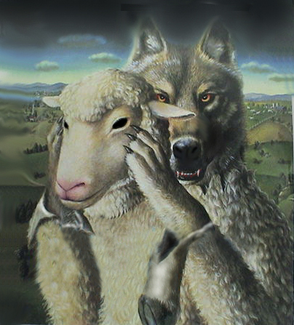
Reasons for self-examination
Scripture commands self-examination
To ensure we aren’t going through the motions
Satan is deceptive
1 Cor. 11:27-29
2 Cor. 13:5

Slide 4
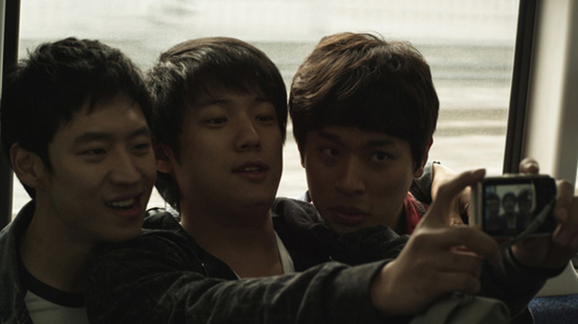
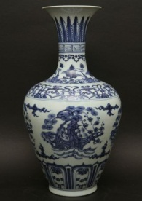
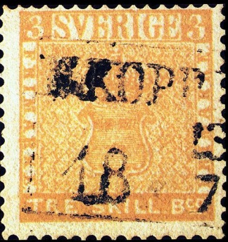
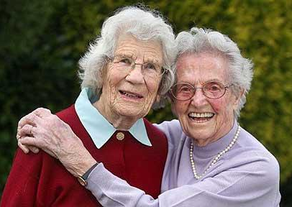
Things to examine
Relationships
Possessions
Time

Slide 5
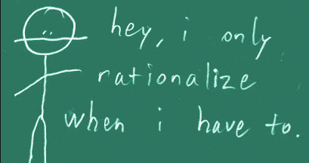
Dangers of self-examination
We may not realize Satan’s deception
We may rationalize our temptation/sin
We may get discouraged and give up

Slide 6
Next Week
Strategies to resist temptation (part 1)

