Slide 1


Week 11: Strategies (Part 1)
Trials and Temptations

Slide 2

Strategy
“The essence of strategy is choosing what not to do.” ~ Michael Porter

Slide 3
1 Corinthians 10:13
“No temptation has overtaken you except such as is common to man; but God is faithful, who will not allow you to be tempted beyond what you are able, but with the temptation will also make the way of escape, that you may be able to bear it.”
Recognize the temptation
Look for the way of escape

Slide 4
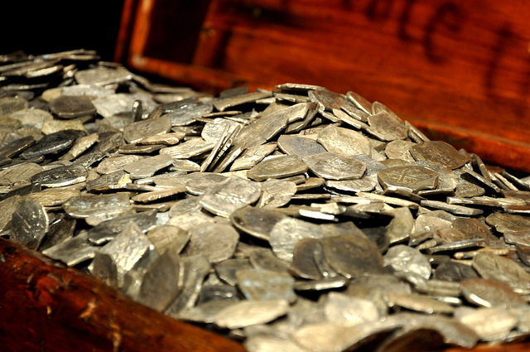
Abram
Genesis 14:8-24
How did he resist?

Slide 5
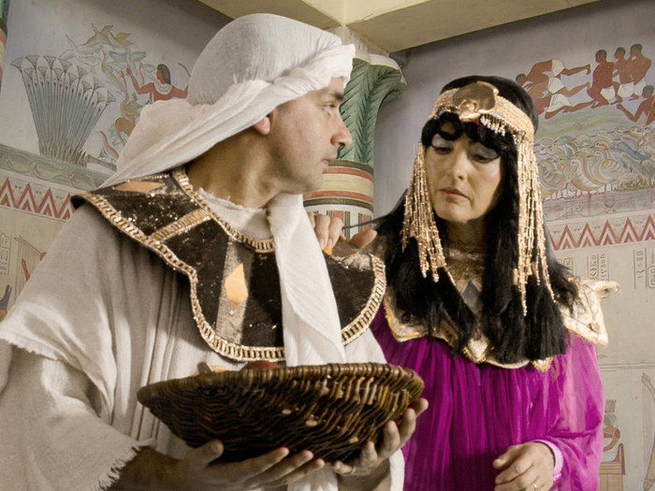
Joseph
Genesis 39:1-12
How did he resist?

Slide 6

Job
“I have made a covenant with my eyes;
Why then should I look upon a young woman?” ~ Job 31:1

Slide 7
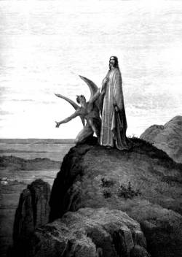
Jesus
Matthew 4:1-11
How did he resist?

Slide 8
Make no provision for the flesh
“But put on the Lord Jesus Christ, and make no provision for the flesh, to fulfill its lusts.” ~ Romans 13:14
What does it mean to “make no provision for the flesh”?

Slide 9
Prayer
“Coming out, He went to the Mount of Olives, as He was accustomed, and His disciples also followed Him. ⁴⁰ When He came to the place, He said to them, ‘Pray that you may not enter into temptation.’” ~ Luke 22:39-40
How is prayer a strategy for resisting temptation?

Slide 10
Accountability Partner
“Confess your trespasses to one another, and pray for one another, that you may be healed. The effective, fervent prayer of a righteous man avails much.” ~ James 5:16
“As iron sharpens iron, so a man sharpens the countenance of his friend.” ~ Proverbs 27:17
How can an accountability partner help you resist temptation?

Slide 11

Next Week
Strategies to resist temptation (part 2)

