Slide 1
Week 12: Strategies (Part 2)
Trials and Temptations

Slide 2
Choose the Good Things
Colossians 3:1
Philippians 4:8

Slide 3
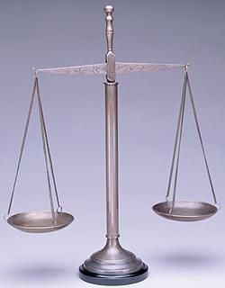
Comparative Sins
James 2:10
Romans 3:23
Romans 6:23a

Slide 4
Disappointment
Genesis 6:5-6
Luke 15:11-32

Slide 5
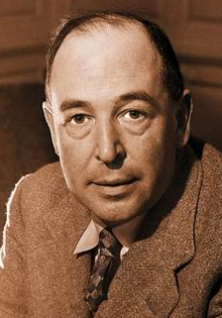
Triggers
“We must learn by experience to avoid either trains of thought or social situations which for us (not necessarily for everyone) lead to temptations. Like motoring—don’t wait till the last moment before you put on the brakes but put them on, gently and quietly, while the danger is still a good way off.”

Slide 6
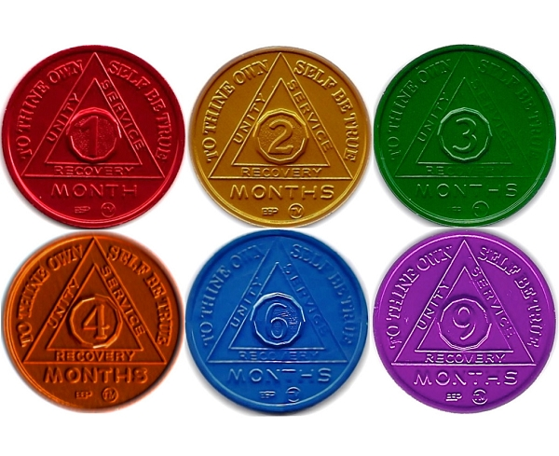
Alcoholics Anonymous
“We admitted we were powerless over alcohol —
that our lives had become unmanageable.”

Slide 7
Change your response…
What is the difference between the three phrases below as it relates to resisting temptation?
“I can’t…”
“I shouldn’t…”
“I don’t…”

Slide 8
Retrain Your Brain
Recognize a temptation
Create a reward for when you resist temptation

Slide 9
Additional Strategies?

Slide 10
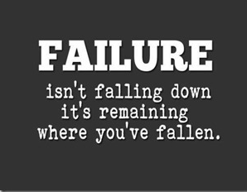
Next Week
Stumbling, Falling, and Getting up

