Slide 1
Week 13: Stumbling, Falling, and Getting Up
Trials and Temptations

Slide 2
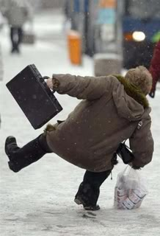
We all slip eventually…

Slide 3
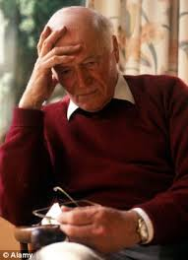
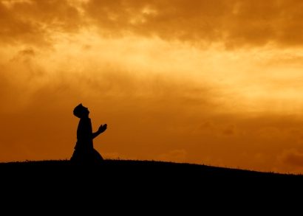
Sorrow and Repentance
“You can have sorrow without repentance, but you cannot have repentance without sorrow.”

Slide 4
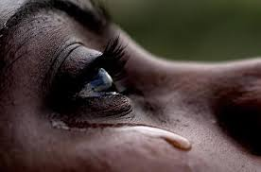
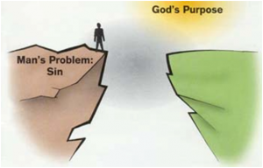
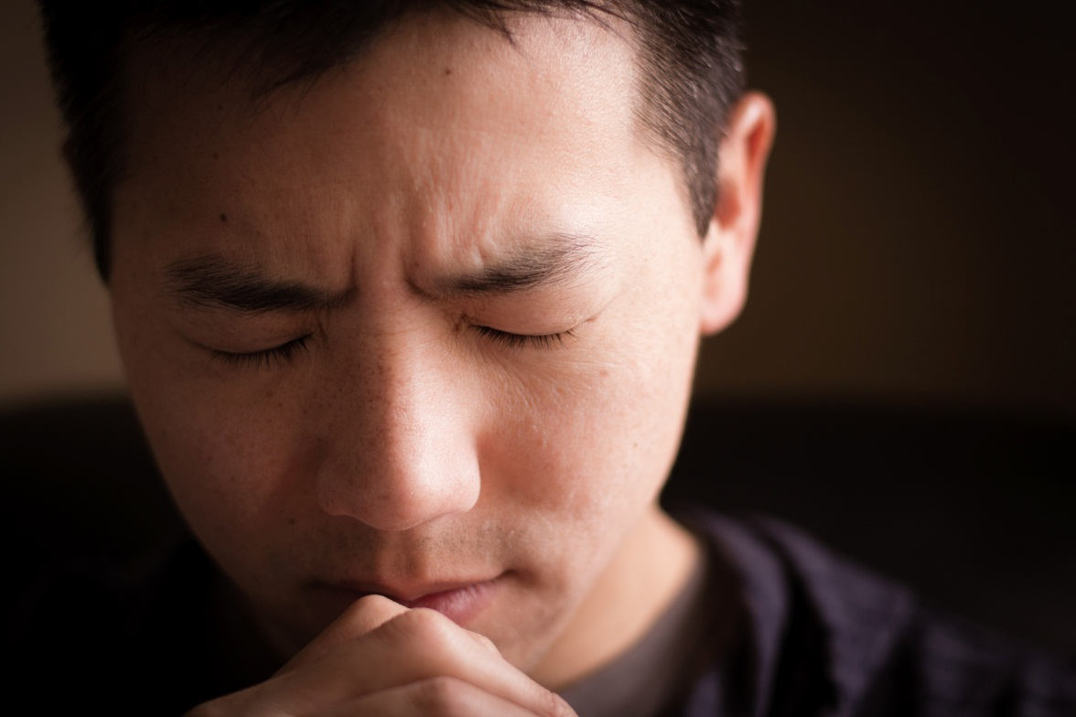
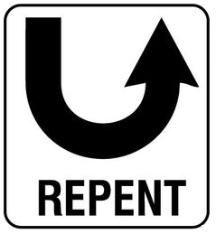
Steps of Repentance
Recognize sin separates us from God
Godly sorrow
Asking for forgiveness
Turn to God
Do works befitting repentance

Slide 5
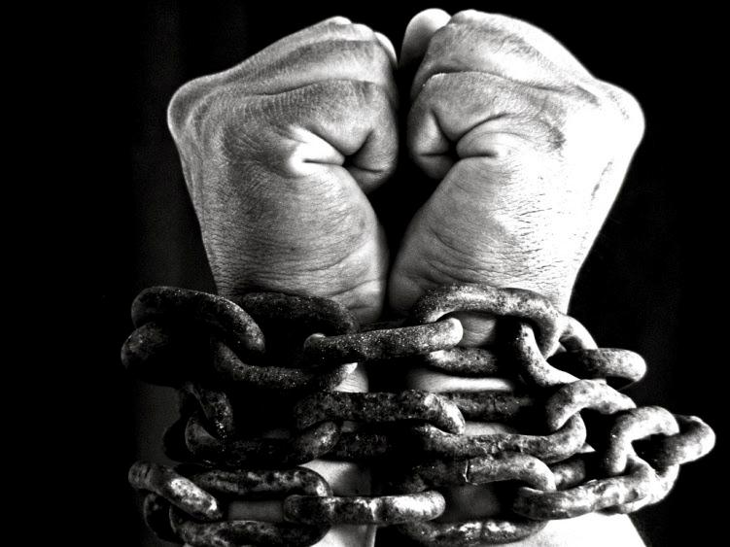
Habitual Sin
Encouraging verses:
“If we confess our sins, He is faithful and just to forgive us our sins and to cleanse us from all unrighteousness.” ~ 1 John 1:9
“Then Peter came to Him and said, 'Lord, how often shall my brother sin against me, and I forgive him? Up to seven times?' Jesus said to him, 'I do not say to you, up to seven times, but up to seventy times seven.’” ~ Matthew 18:21-22

Slide 6
Habitual Sin
Concerning verses:
“For if we sin willfully after we have received the knowledge of the truth, there no longer remains a sacrifice for sins, but a certain fearful expectation of judgment, and fiery indignation which will devour the adversaries.” ~ Hebrews 10:26-27
“For if, after they have escaped the pollutions of the world through the knowledge of the Lord and Savior Jesus Christ, they are again entangled in them and overcome, the latter end is worse for them than the beginning. For it would have been better for them not to have known the way of righteousness, than having known it, to turn from the holy commandment delivered to them.” ~ 2 Peter 2:20-21

Slide 7
Conclusion

