Slide 1
Week 2: A look at sorrows and the source of various trials
Trials and Temptations

Slide 2
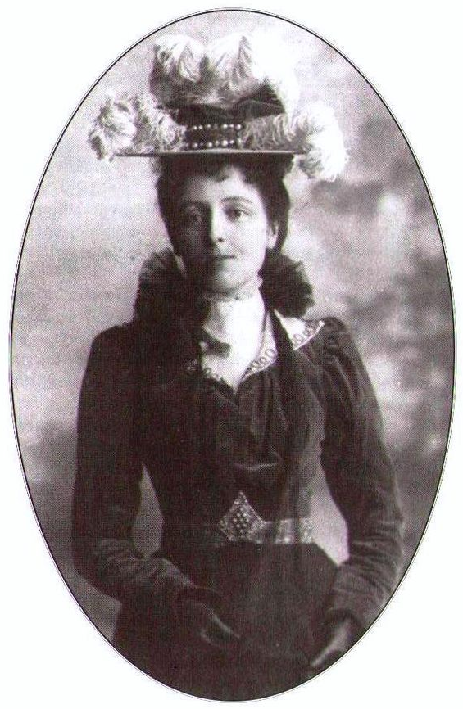
L.M. Montgomery
“...the sorrows God sent us brought comfort and strength with them, while the sorrows we brought on ourselves, through folly or wickedness, were by far the hardest to bear.”

Slide 3
Sorrows
Child not doing well at school
Pet dies
Lost job
Normal day
Cancer
Spouse/child passes away
Sorrow Meter

Slide 4
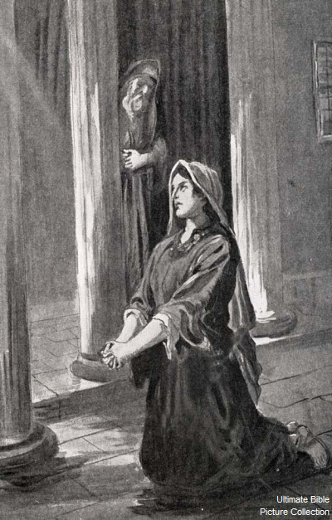
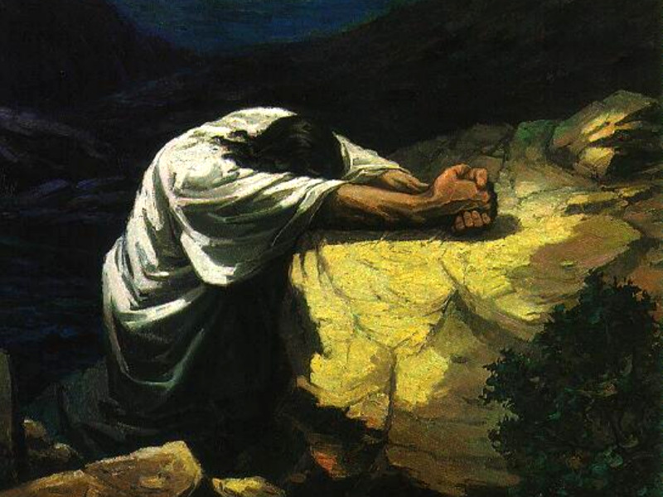
Biblical examples of sorrow from trials
Hannah (1 Samuel 1:1-10)
Jesus (Luke 22:39-46)

Slide 5
L.M. Montgomery
“...the sorrows God sent us brought comfort and strength with them, while the sorrows we brought on ourselves, through folly or wickedness, were by far the hardest to bear.”

Slide 6
Trials from God
Deuteronomy 7:1-2
Judges 2:20-23

Slide 7
Trials from Bad Decisions
Judges 16
1 Kings 12:8-15
As seen on Facebook…
Everything happens for a reason. Sometimes the reason is you’re stupid and you make bad decisions.

Slide 8
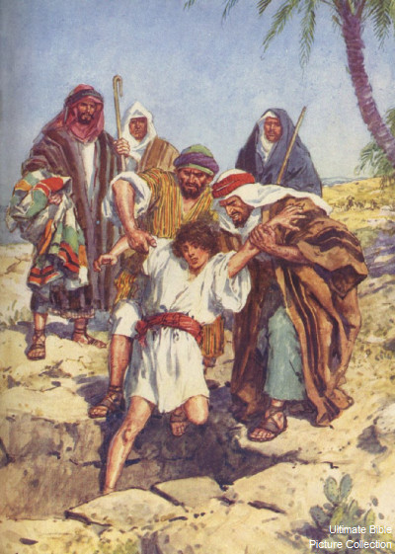
Trials from the Outside World
Persecution: 1 Peter 4:12-14
Mistreatment: Genesis 37:3-4

Slide 9
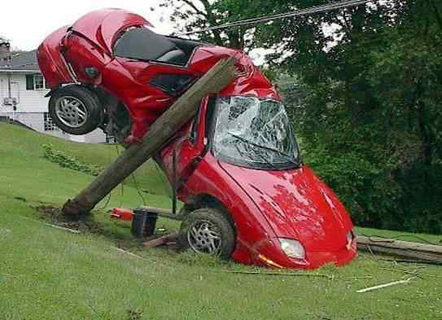
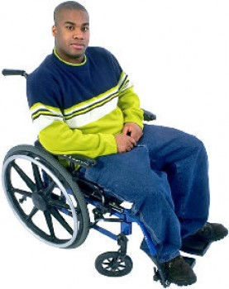
Trials from Random Events

Slide 10
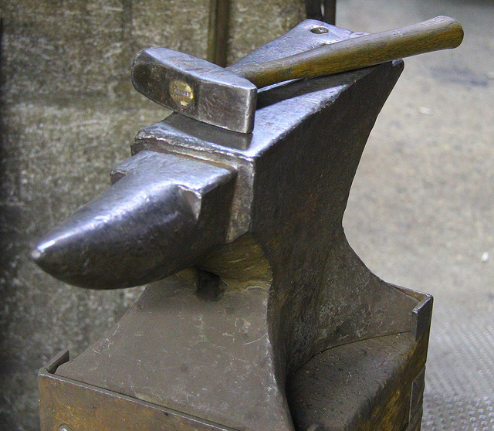
Next Week
“We are always on the anvil; by trials God is shaping us for higher things.” ~ Henry Ward Beecher
Purpose of trials
Lessons we can learn from trials

