Slide 1
Week 3: Purposes and Lessons from Trials
Trials and Temptations

Slide 2
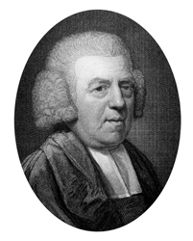
John Newton
“Trials are medicines which our gracious and wise physician prescribes because we need them; and he proportions the frequency and weight of them to what the case requires.”

Slide 3
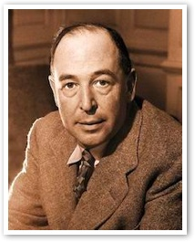
Purpose: Get Our Attention!
“God whispers to us in our pleasures, speaks in our conscience, but shouts in our pain…it is his megaphone to rouse a deaf world.” ~ C.S. Lewis

Slide 4
Purpose: Discipline
“My son, do not despise the chastening of the Lord, nor be discouraged when you are rebuked by Him; For whom the Lord loves He chastens, and scourges every son whom He receives.” ~ Hebrews 12:6 (NKJV)

Slide 5
Purpose: Test your Faith
“My brethren, count it all joy when you fall into various trials, knowing that the testing of your faith produces patience. ” ~ James 1:2-3 (NKJV)

Slide 6
Purpose: Keep us Humble
“And lest I should be exalted above measure by the abundance of the revelations, a thorn in the flesh was given to me, a messenger of Satan to buffet me, lest I be exalted above measure.” ~ 2 Corinthians 12:7 (NKJV)

Slide 7
Purpose: Dependence on God

Slide 8
Purpose: Empathy
“Blessed be the God and Father of our Lord Jesus Christ, the Father of mercies and God of all comfort, who comforts us in all our tribulation, that we may be able to comfort those who are in any trouble, with the comfort with which we ourselves are comforted by God.”
~ 2 Corinthians 1:3-4

Slide 9
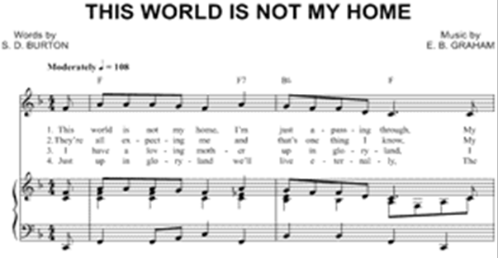
Purpose: Yearn for Home
“For our citizenship is in heaven, from which we also eagerly wait for the Savior, the Lord Jesus Christ…” ~ Philippians 3:20

Slide 10
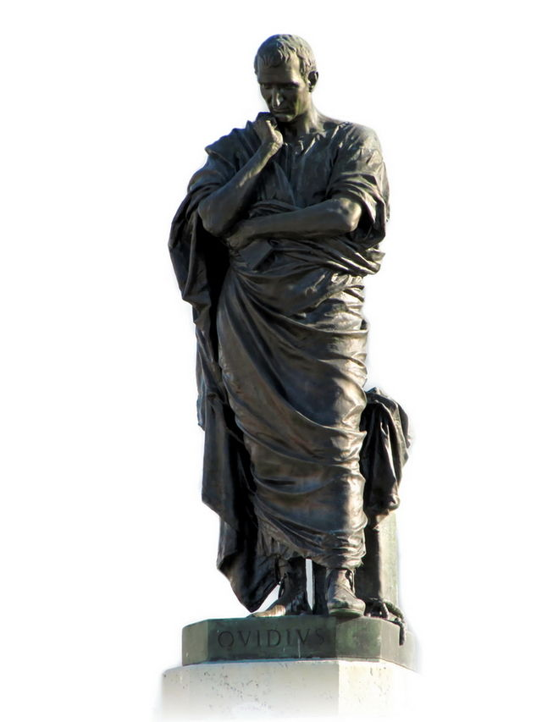
Next Week
“Bear and endure: This sorrow will one day prove to be for your good.”
~ Ovid
Tools can we use to endure trials

