Slide 1
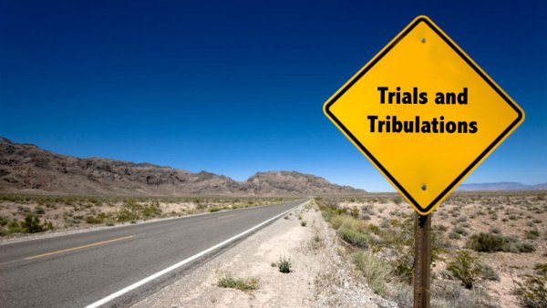
Week 4: Trial Strategies
Trials and Temptations

Slide 2
Hebrews 10:36 (NKJV)
“For you have need of endurance, so that after you have done the will of God, you may receive the promise”

Slide 3
Job’s Responses
Grief
Worship
Did not let trials turn into temptation
Meditation

Slide 4
Strategies from James 1
² My brethren, count it all joy when you fall into various trials
³ knowing that the testing of your faith produces patience.
⁴ But let patience have its perfect work, that you may be perfect and complete, lacking nothing.
⁵ If any of you lacks wisdom, let him ask of God, who gives to all liberally and without reproach, and it will be given to him.

Slide 5
Additional Strategies
Express your feelings in a Godly manner – Psalm 13
Volunteer
Take things one day at a time

Slide 6
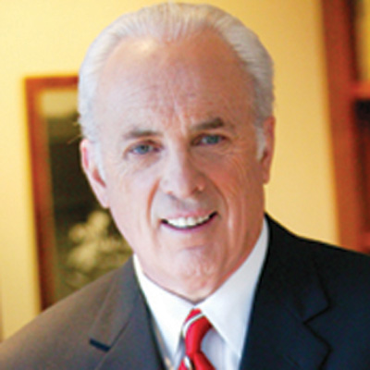
Next Week
“Since the fall in the garden of Eden, temptation has been a constant, unrelenting part of human life.”
~ John MacArthur
Origins, examples, and purpose of temptation

