Slide 1
Week 5: Defining Temptation
Trials and Temptations

Slide 2
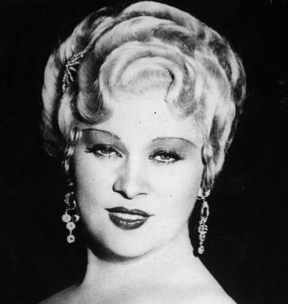
Worldly View
“I generally avoid temptation unless I can't resist it.” ~ Mae West

Slide 3
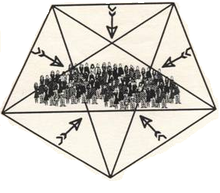
Origins of Temptation
Not from God
Ultimately from Satan
From our own desires
Satan uses other people
“Let no one say when he is tempted, ‘I am tempted by God’; for God cannot be tempted by evil, nor does He Himself tempt anyone.”
~ James 1:13 (NKJV)
Tempter
“But each one is tempted when he is drawn away by his own desires and enticed.”
~ James 1:14 (NKJV)
Accuser
Adversary
“My son, if sinners entice you, do not consent.”
~ Proverbs 1:10 (NKJV)
Liar
Murderer

Slide 4
Temptation and Sin
Temptation is an invitation to sin
Temptation is not sin

Slide 5
Temptation and Sin
Eve’s temptation (Genesis 3:1-7)
When did temptation turn to sin?
a. When she listened to the Devil the 1st time.
b. When she answered the Devil.
c. When she listened to the Devil the 2nd time.
d. When she looked at the fruit.
e. When she reasoned the fruit was good.
f. When she took the fruit.

Slide 6
Temptation and Sin
Flow chart (James 1:14-15)
Satan
Resist
Desire
Action
Other people
Sin
Death

Slide 7
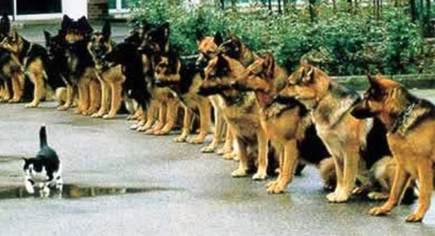
Reasons for Temptations
Allows us to make free will choices
Proves God’s power and promise
Strengthens those who resist
Reminds us we cannot earn Heaven

Slide 8
Next Week
“For all that is in the world—the lust of the flesh, the lust of the eyes, and the pride of life—is not of the Father but is of the world.”
~ 1 John 2:16 (NKJV)
Three types of temptation
Biblical examples

