Slide 1
Week 7: Lust of the Flesh
Trials and Temptations

Slide 2
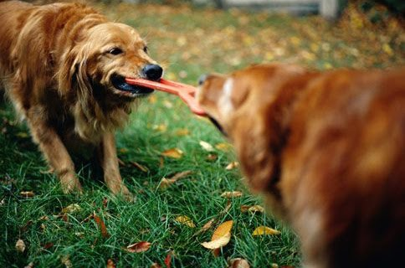
Gal 5:17 (NKJV)
“For the flesh lusts against the Spirit, and the Spirit against the flesh; and these are contrary to one another, so that you do not do the things that you wish.”

Slide 3
The Flesh
Flesh = body + mind

Slide 4
The Flesh
Not originally sinful Gen 1:26-27
After sinning, notice how Seth is described
Genesis 5:3 “And Adam lived one hundred and thirty years, and begot a son in his own likeness, after his image, and named him Seth.”

Slide 5
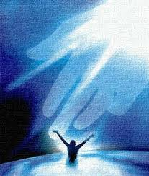
The Spirit
Key text Roman 8:12-17
“16 The Spirit Himself bears witness with our spirit that we are children of God”

Slide 6
The Battle Within
Two dogs illustration
Paul’s battle described in Romans 7:14-25

Slide 7
Training Required
Discipline and bring into subjection (1 Cor 9:27)
Make no provision for the flesh (Rom 13:14)
Walk in the Spirit (Gal 5:16)
Meditate on good things (Php 4:8)

Slide 8
Next Week
A closer look at the “lust of the eyes”

