Slide 1
Week 8: Lust of the Eyes
Trials and Temptations

Slide 2
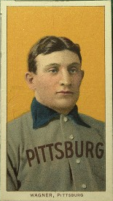
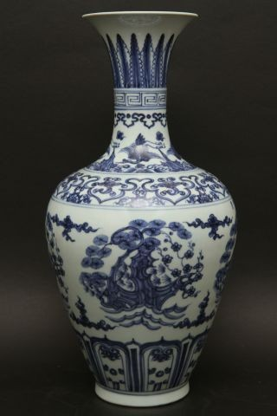
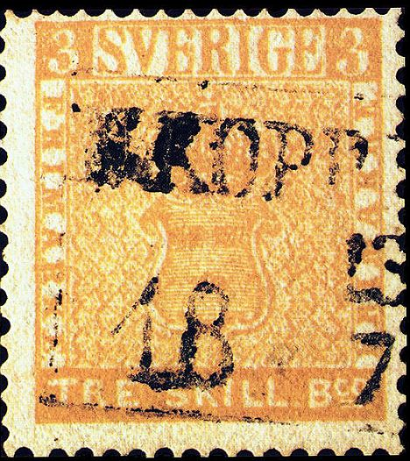
What do these things have in common?

Slide 3
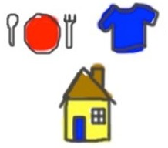
Needs, Wants, and Lusts
Wants
Needs
Lusts

Slide 4
Three-Step Process
We perceive something
We desire it in our heart
We take action on what we desire

Slide 5
Why are we so susceptible to the lust of the eyes?
We are discontented
Immediate self-gratification
“We have produced a world of contented bodies and discontented minds.” ~ Adam Clayton Powell

Slide 6
Next Week
A closer look at the “pride of life”

