Slide 1
Week 9: Pride of Life
Trials and Temptations

Slide 2
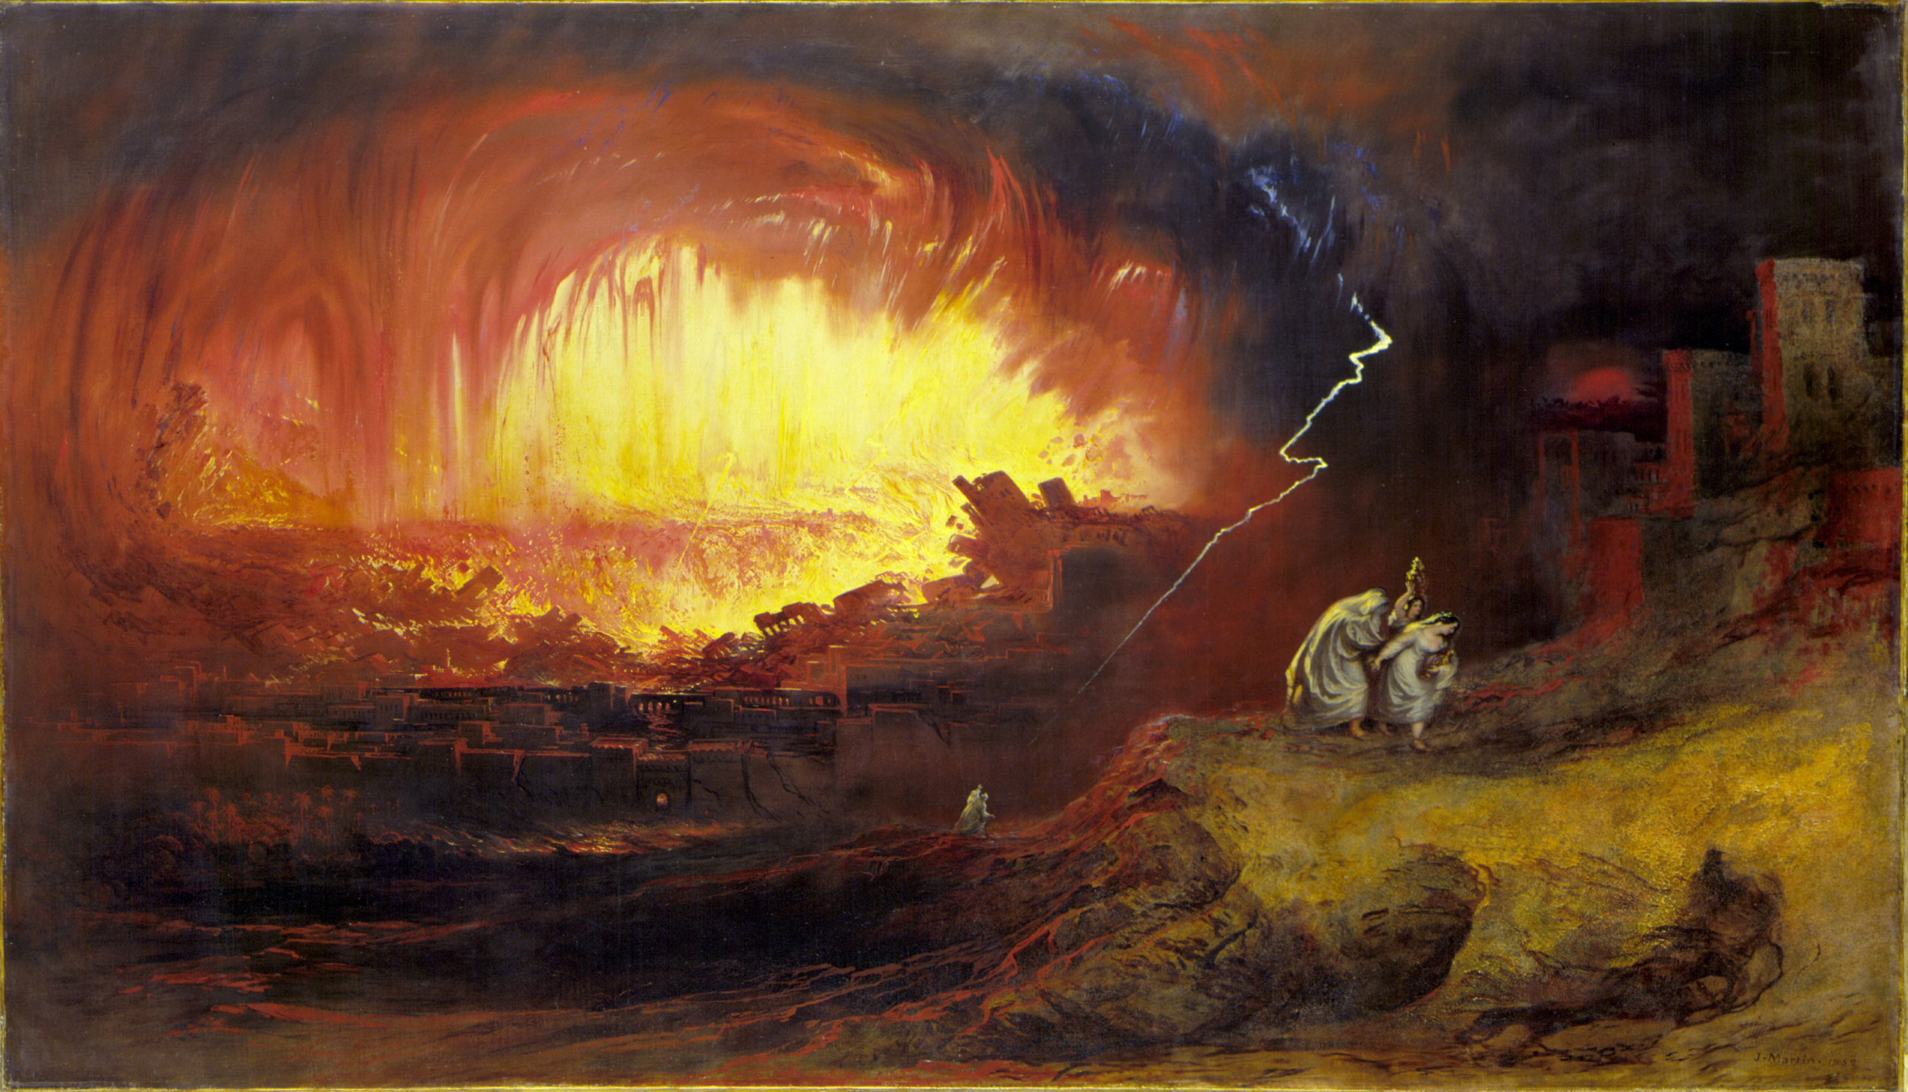
Sodom & Gomorrah

Slide 3
How the pride of life develops
Discontentment
Abundance
Focus on self
Desire to elevate ourselves

Slide 4
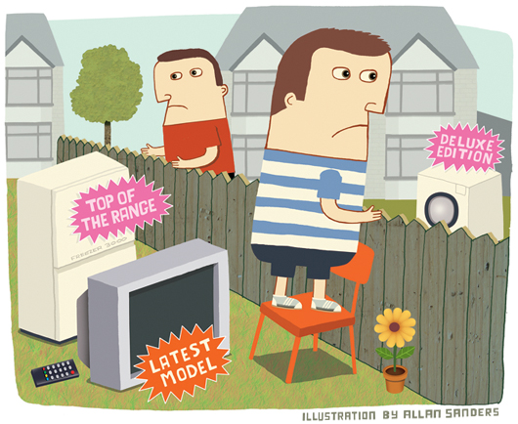
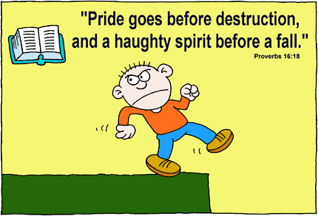
How to recognize pride in our lives
Checking the “social mirror”
Anger and bitterness
Falling (often)

Slide 5
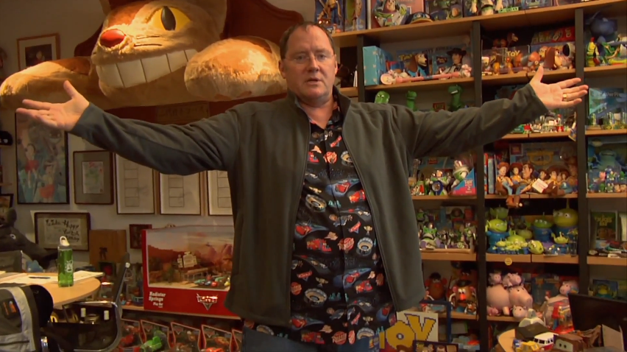
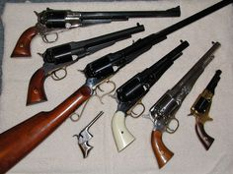
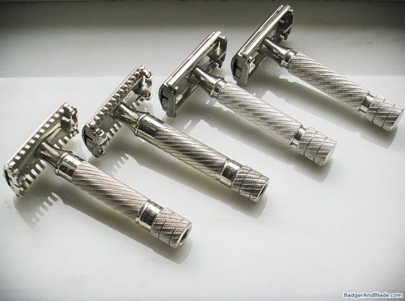
The Link Between Pride and…
… lust of the flesh
… lust of the eyes
XXX

Slide 6
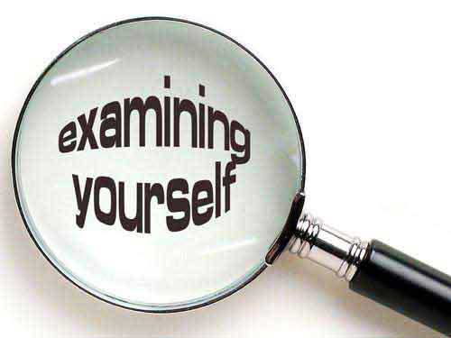
Next Week
Recognizing Your Temptation(s)

